Slide 1
Blind Search (Uniformed Search)
Notes based from Dr. Eamonn Keogh

Slide 2
Search as a lens to view the world
Once you understand search, you begin to see it everywhere…
You see it as a tool to explain things, like evolution, economics etc.
You see it as a tool to solve problems

Slide 3
Search as a lens to view the world
Once you understand search, you begin to see it everywhere…
You see it as a tool to explain things, like evolution, economics etc.
You see it as a tool to solve problems
Search for Archelogy problems
Search for defense/law enforcement problems

Slide 4
Examples of search trees.
15 puzzle
Peg solitare (or solo noble)
The puzzle can be shuffled into 10,461,384,944,000 different solvable positions (about 10.5 trillion)
In the worst case, it can take 80 moves to solve a puzzle (the diameter is 80)
The problem of finding an optimal solution is known to be NP-hard, for the general case of sliding tile puzzles.
Peg solitare is a board game for one player involving movement of pegs on a board with holes
The standard game fills the entire board with pegs except for the central hole. The objective is to make valid moves, and then empty the entire board except for a solitary peg in the central hole

Slide 5
Examples of Problem Space problems
A shipping dock:
Swap the containers marked A and B in as few moves as possible
Uber drivers
Toads and frogs puzzle
Rearranging two sides of road so that the green frogs go from the left to the rights and vice versa

Slide 6
Problem Solving using Search
To solve problems with search, we need two things
The Problem Space
The Search Algorithm
As we will see today, these two things are completely independent of each other.
Let’s look at problem space first

Slide 7
Problem Solving using Search
A problem Space consists of
The current state of the world (initial state)
A description of the actions we can take to transform one state of the world into another (operators)
A description of the desired state of the world (goal state), this could be implicit or explicit
A solution consists of the goal state*, or apath to the goal state
*Problems where the path doesn’t matter are known as “constrain satisfaction” problems

Slide 8
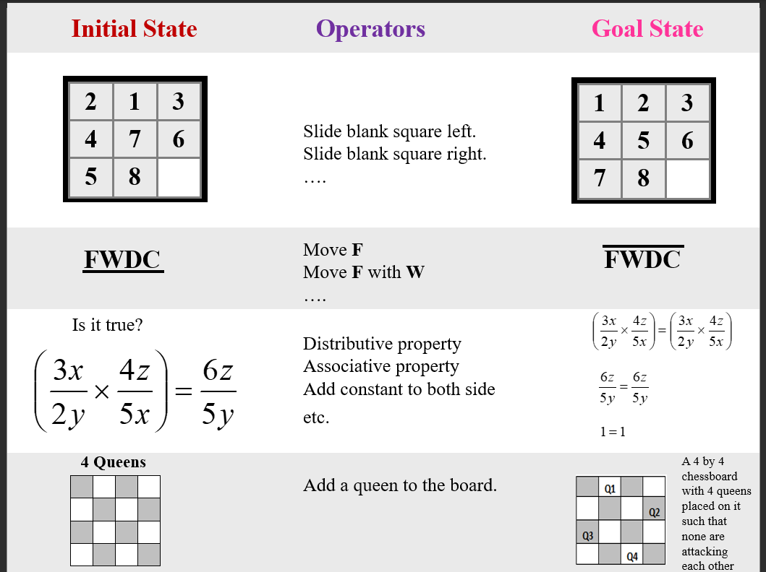

Slide 9
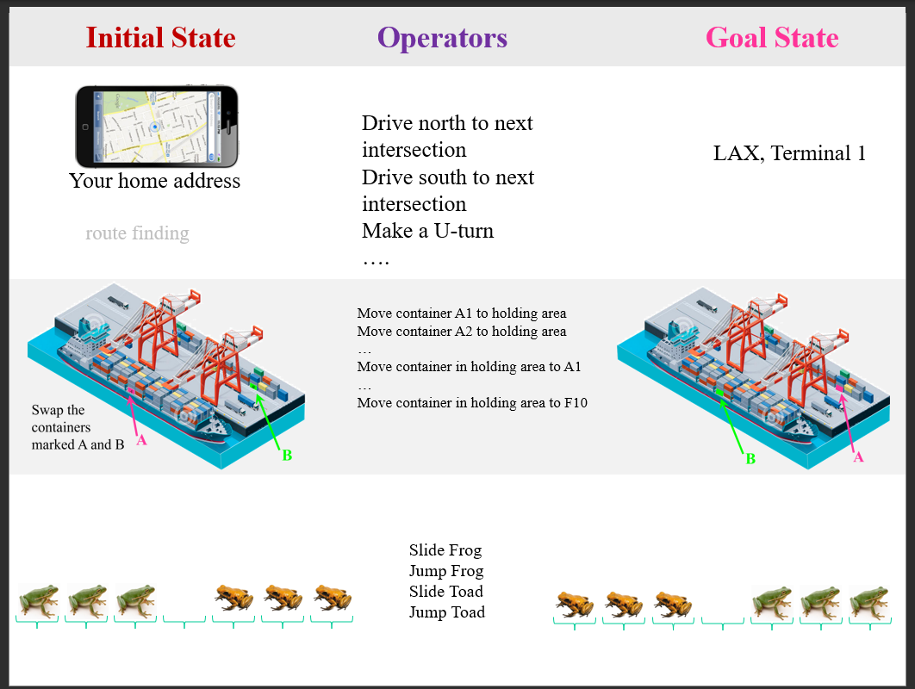

Slide 10
Representing a state

Slide 11
Representing the States
For the 8-puzzle
3 by 3 array
5, 6, 7
7, 4, Blank
3, 1, 2
A vector of length nine
5,6.7.8.4, BLANK, 3, 1, 2
A list of facts
Upper_left = 5
Upper_middle = 6
…
A state space should describe
Everything that is needed to solve the problem.
Nothing that is not needed to solve the problem
In general, many possible representations are possible, choosing a good representation will make solving the problem much easier.
Choose the representation that make the operators easiest to implement, and if possdible, has the lowest branching factor

Slide 12
Operators I
Single atomic actions that can transform one state into another
You must specify an exhaustive list of operators, otherwise the problem may be unsolvable. Example U-turn
Operators consist of
Precondition: Description of any conditions that must be true before using the operator
Instruction on how the operator changes the state

Slide 13
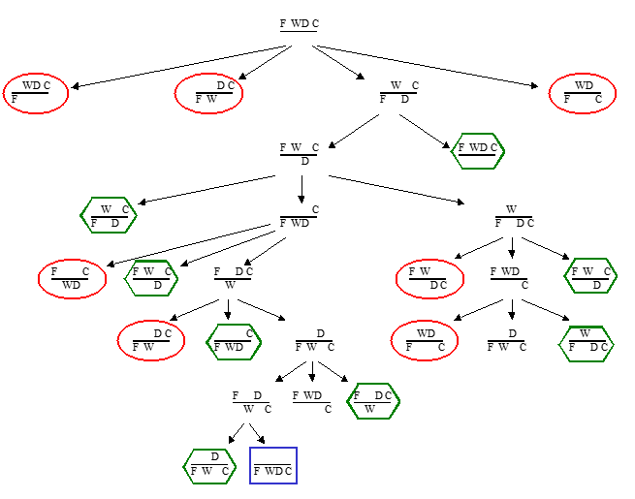
Once we have defined the problem space (state representation, the initial state, the goal state and operators) are we done?
We start with the initial state and keep using the operators to expand the nodes till we find a goal state
…but the search space might be large…
…really large…
So we need some systematic way to search

Slide 14
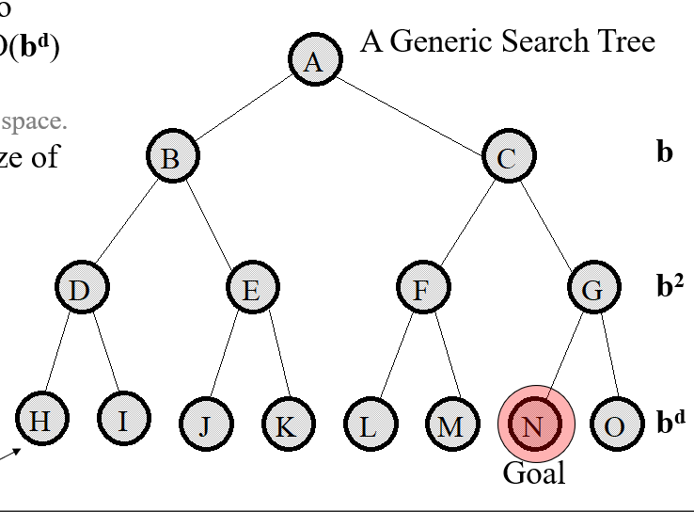
The average number of new nodes we create when expanding a new node is the (effective) branching factor b
The length of a path to a goal is the depth d
So visiting every node in the search tree to depth d will take O(b^d) time.
Not necessary O(b^d) space
This we call the size of the problem space.

Slide 16
Examples
Branching factors for some problems
Eight puzzle has a branching factor of 2.13 so a search tree at depth 20 has about 3.7 million nodes
Rubik’s cube has a branching factor of 13.34. There are 42,252,003,274
Frogs and toads has a branching factor of about 2

Slide 17
The diameter of a problem
The diameter of a problem is the depth of the longest solution, i.e. the worst case
The diameter is sometimes called God’s Number
-For the 3-puzzle, the diameter is 6
-For the 8-puzzle the diameter is 31
-For the 15-puzzle the diameter is 80
The diameter of a problem
For route finding, the diameter is approximately the diameter of the smallest circle that includes all the roads

Slide 18
We are going to consider different techniques to search the problem space, we need to consider what criteria we will use to compare them
Completeness: Is the technique guaranteed to find an answer (if there is one)
Optimality: Is the technique guaranteed to find the best answer (if there is more than one). (Remember that operators can have different costs)
Time complexity: How long does it take to find a solution
Space Complexity: How much memory does it take to find a solution

Slide 19
General (generic) Search Algorithm
Function general-search(problem, QUEUING-FUNCTION)
Nodes = MAKE-QUEUE(MAKE-NODE(problem.INITIA-STATE))
Loop do
If (empty(nodes) then return “failure”
Node = REMOVE-FRONT(nodes)
If problem.GOAL-TEST(nodes.STATE) succeeds then return node
Nodes = QUEUING-FUNCTION(nodes, EXPAND(node, problem.OPERATORS))
End
A nice fact about this search algorithm is that we can use a single algorithm to do many kinds of search. The only difference is in how the nodes are placed in the queue.

Slide 20
